Slide 1




OOP Project Report
GUI-Based
Brick-Breaker Game
Hrithik Chugh

Slide 2
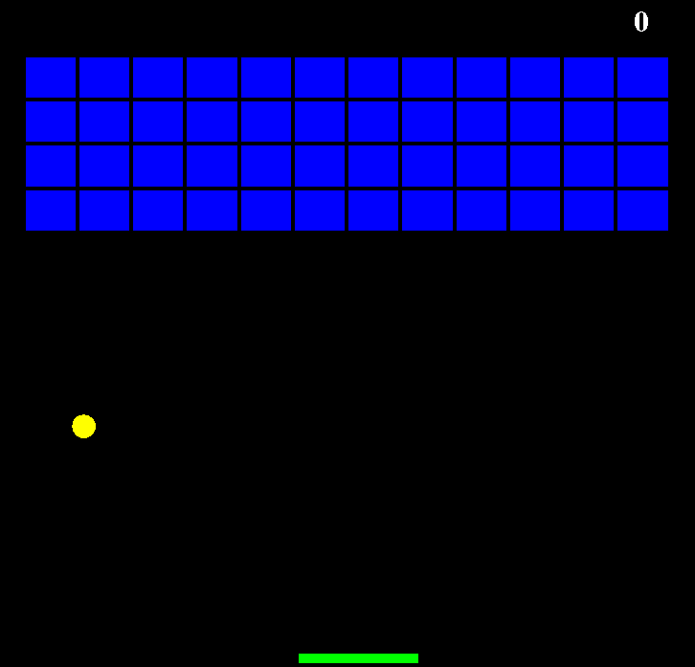
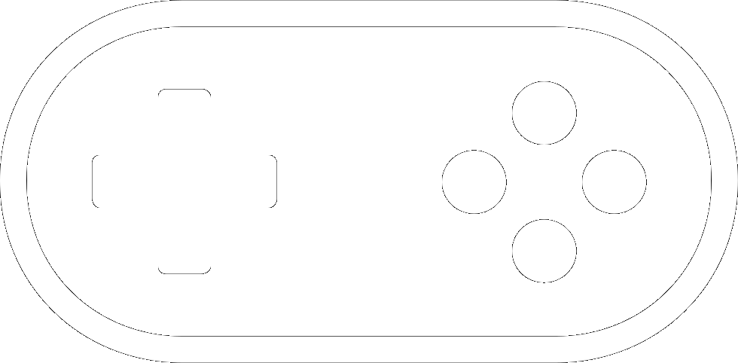
What and not how, the proposed game (as would be seen by the user):
Layout (Window components):
Brick matrix
A bar
A ball
Score board

Slide 3
Gameplay properties (functionalities proposed):
Ball movement: Real physical 2D motion.
Collision & rebound: Ball – Bar.
Collision, rebound & Destruction: Ball – Bricks & Score++.
Levels.
Specials: Random destructions cause:
Rotation of the gameplay area (Eq. of Circle). [Unique]
Ball Speed change.
Bar Size change.
Fire ball (destruction of the peripheral bricks)
Pass-through Ball.
Multiple Balls.
Left-Right Bar direction interchange.

Slide 4
Domain specific & Developmental complexities gained due to the proposed functionalities and inherent game characteristics:
GUI using AWT & Swing and other advanced concepts:
Features (especially gameplay area rotation): Eq. of Circle.
Gameplay area: Container – JFrame & component container – JPanel.
Rendering figures & their placement: The Graphics API.
Bar & Ball movement: Event Handling – Event classes & Listener interfaces.
Detecting collisions: Rectangle Class.
Game frames: Swing Timer Class.

Slide 5
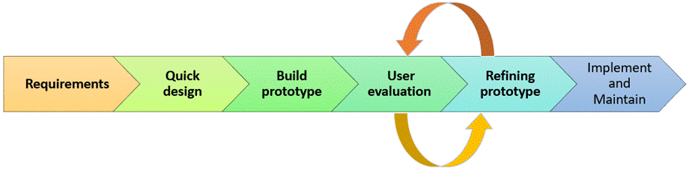
Software Engineering Model used:
Prototype Model:
According to the scale of our project.

Slide 6
Java Database Connectivity (JDBC)
Stores:
Username & Score.
Steps to work with JDBC:
Import packages:
import java.sql;
import javax.sql;
Loading & registering Drivers.
Connection establishment.
DDL, DML & DQL commands.
Closing connections.

Slide 7
Other constructs & concepts used:
Basic:
Importing built-in GUI Libraries/APIs.
import javax.swing.*; import java.awt.*;
Iterative control statements.
Decision control statements.
Exception Handling.
OOP related:
Classes & Objects: Provides Encapsulation.
Inheritance: Provides Hierarchical Structure.
Interface: Provides Abstraction.
Methods: Provides Modularity.
4 Major elements
of OOP Model

Slide 8
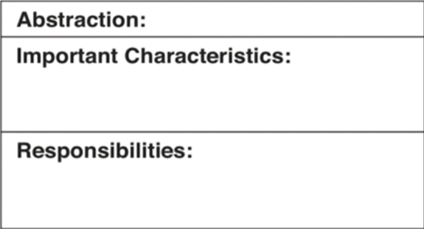

Abstractions identified:
According to the current stage in the whole engineering process.
MapGenerator
Gameplay
Brick Dimensions
Map Dimensions
Ball, Bricks & Bar Coordinate variables & score variable.
Drawing/Generating the Bricks.
Handling key events for the bar.
Handling ball movement & collisions.
H
Gabd
Handling Game frames.

Slide 9
That’s all for now, folks.

